Slide 1
NHLBI
Deep Learning Crash Course
National Heart, Lung, and Blood Institute
Fall 2021

Slide 2
Lecture 1
Course overview

Slide 3
What we want to achieve
Introduce the basics of deep learning
Present in-math how DL model works
Provide practices to build your own model
Grow interest and improve community awareness
Prepare trainees and fellows for DL related jobs
👏After this course and assignments, start to apply DL to your field …

Slide 4


Information and Course Resources
Website - https://github.com/NHLBI-MR/DeepLearningCrashCourse_Fall_2021
Discussion – Slack channels
Assignment – Gradescope, you should receive invitation already!
Office hours – Announced on Slack
Course instructors:
Hui Xue (hui.xue@nih.gov)
David Hansen (davidchansen@gradientsoftware.net)

Slide 5
Assignments
Website - https://github.com/NHLBI-MR/DeepLearningCrashCourse_Fall_2021
Information for Setup
Tech review session this week!
Datasets are for NHLBI only
Require to know python programming
We will demo some basics and how to debug the code
GPU resources
TBD …

Slide 6
Assignments
Assignment 1 : Code up a MLP network for classification
Assignment 2 : Start with Pytorch, CNN
Assignment 3 : CNN in depth and segmentation
Assignment 4 : RNN and transformer
Assignment 5 : Generative model and GAN
Assignment 6 : Data management, experiment management
Assignment 7 : optional, meta learning, model deployment
Use Pytorch https://pytorch.org/
Get yourself familiar with this framework
https://pytorch.org/tutorials/beginner/basics/intro.html
Google, Youtube …

Slide 7

Course logistics
Grading : 50 points per assignment
Pass or fail : Win >70% points
30 late days for assignments
→ NHLBI Office of Education will issue certification
→ Awarding points for providing feedback to course materials and instructors
Circulation. 2020;141:1282–1291
Notes:
Imaging: scan planning, slice tracing, protocol optimization
Recon: including enhancement, quality assessment

Slide 8
Lecture 1
Motivation
Deep learning as a data driven approach
Running examples
Binary and multi-class classification
Multi-layer perceptron (MLP)

Slide 9

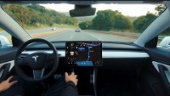
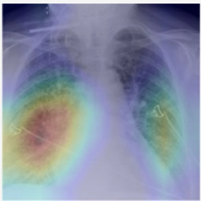
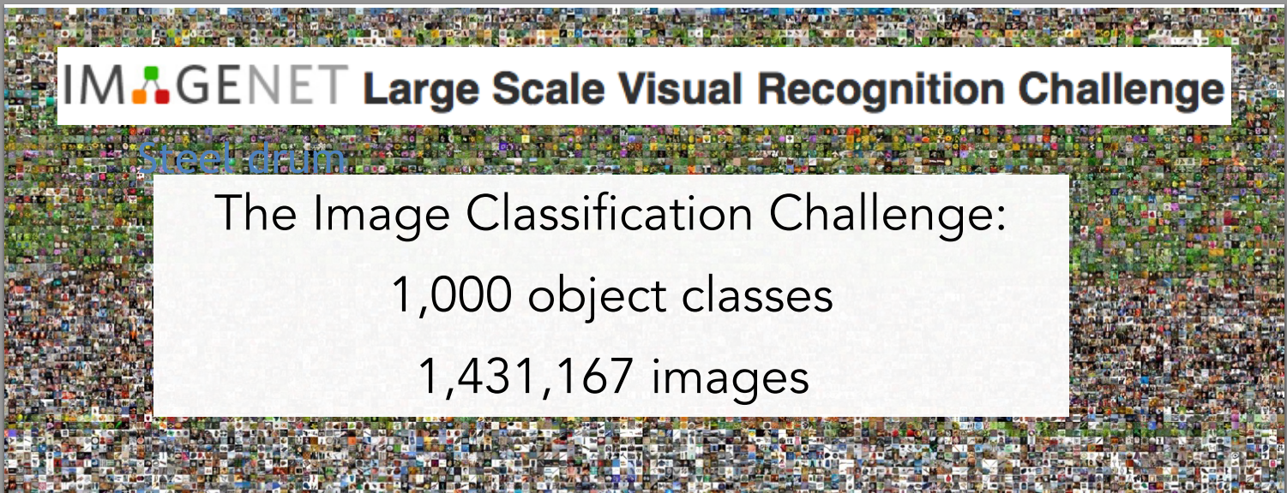
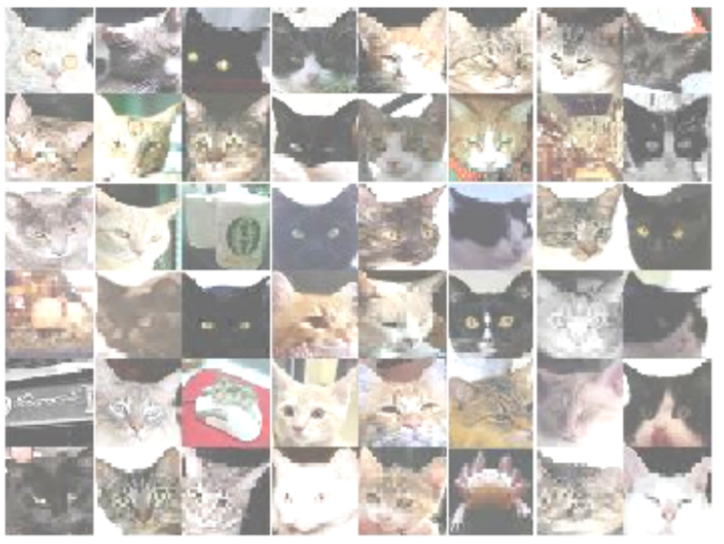
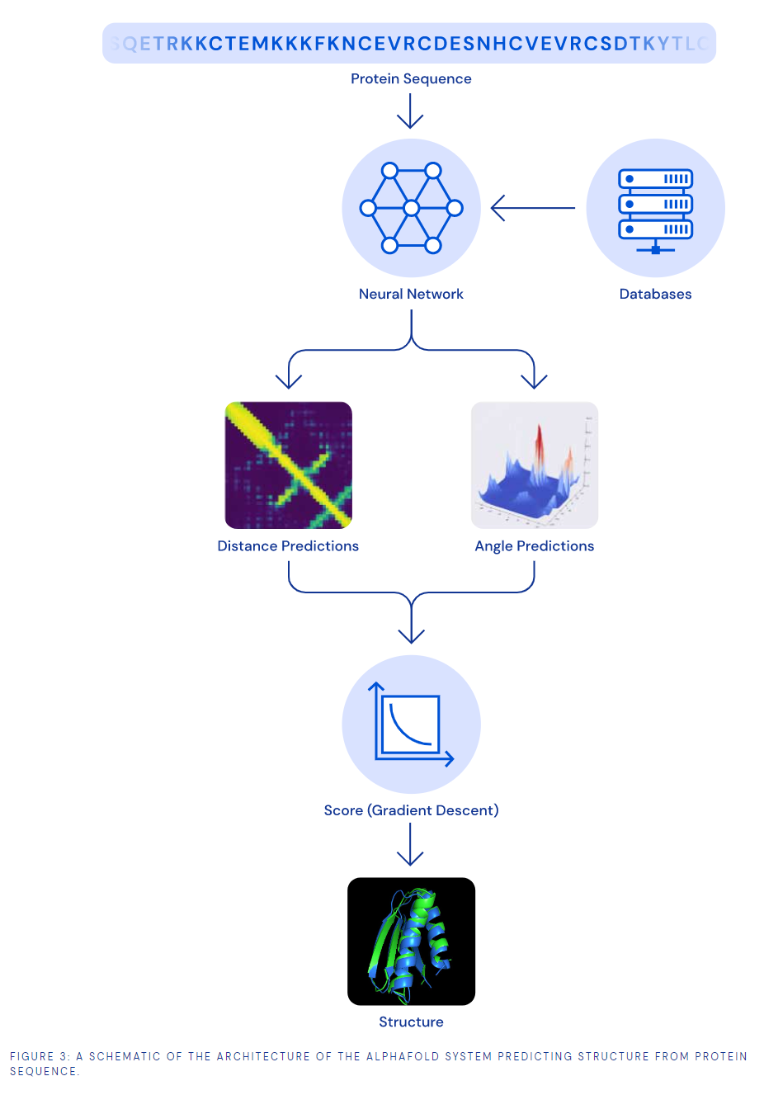
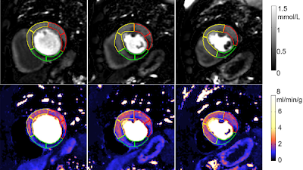
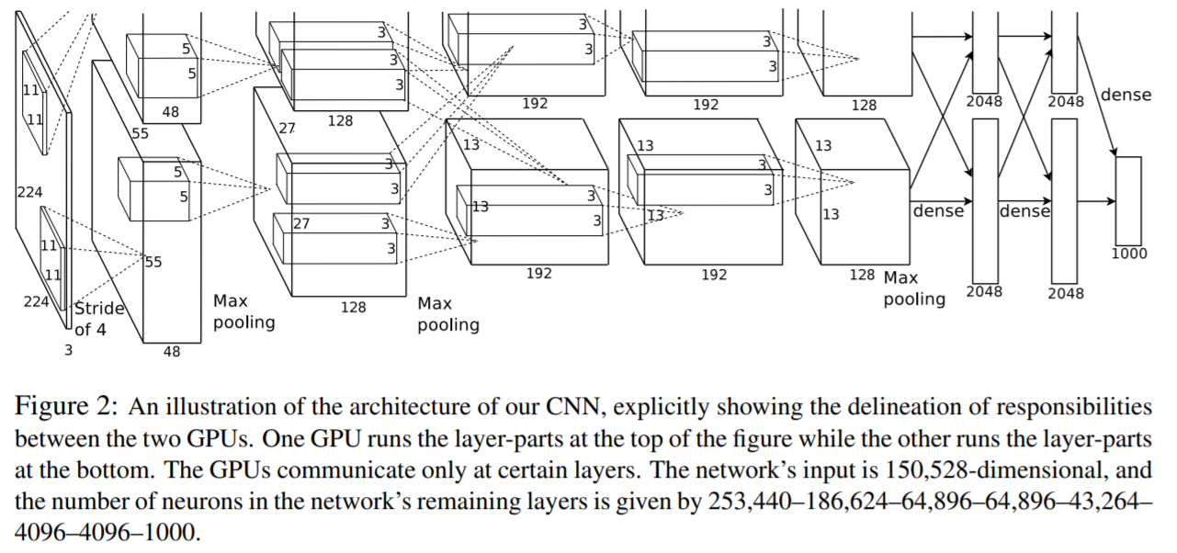
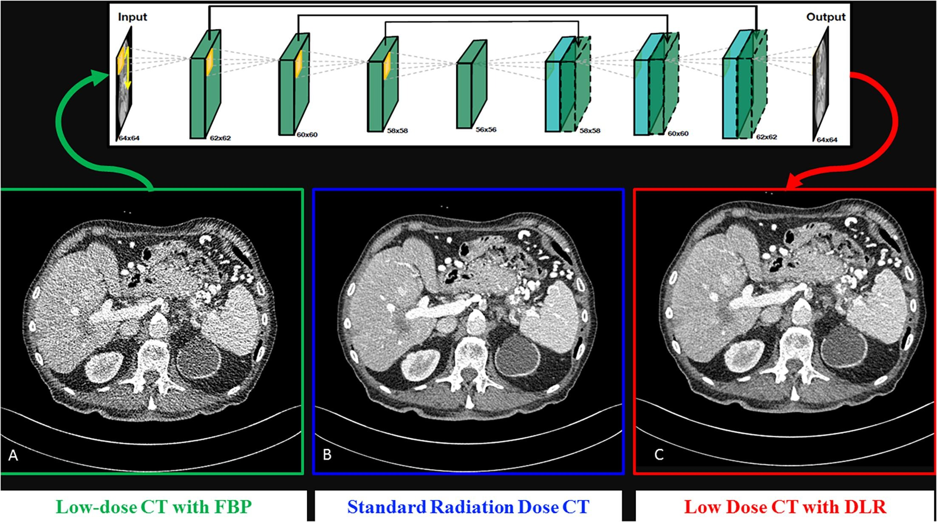
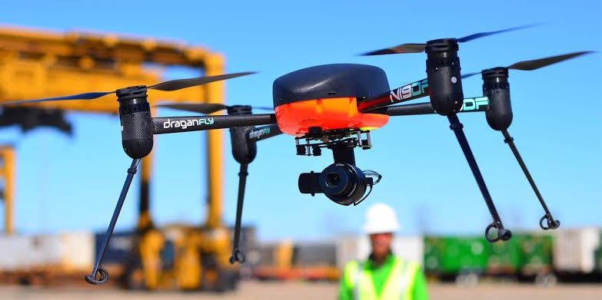
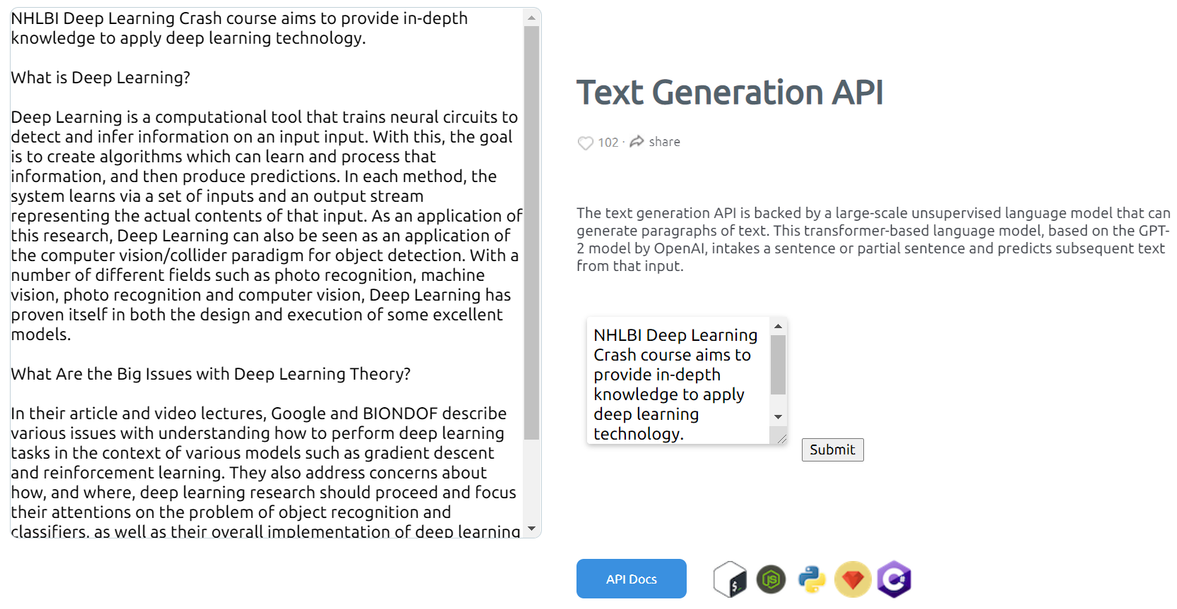
Deep Learning (DL) is making impact in many fields
https://www.youtube.com/watch?v=tlThdr3O5Qo
https://pubs.rsna.org/doi/10.1148/ryai.2021190228
https://pubs.rsna.org/doi/10.1148/ryai.2020200009
Alex net
Google Cat Study -
16000 computers to recognize cat. 2012.
https://deepmind.com/blog/article/AlphaFold-Using-AI-for-scientific-discovery
https://github.com/cs231n/cs231n.github.io
https://www.sciencedirect.com/science/article/pii/S1120179720302866?via%3Dihub
https://dl.acm.org/doi/10.1145/3065386
https://arxiv.org/abs/1112.6209
Deep Learning is one set of core technique which can serve many purposes …
https://medium.com/vsinghbisen/how-ai-based-drone-works-artificial-intelligence-drone-use-cases-7f3d44b8abe3
https://deepai.org/machine-learning-model/text-generator

Slide 10
Deep Learning (DL) is making impact in many fields
https://www.youtube.com/watch?v=tlThdr3O5Qo
https://pubs.rsna.org/doi/10.1148/ryai.2021190228
https://pubs.rsna.org/doi/10.1148/ryai.2020200009
Alex net
Google Cat Study -
16000 computers to recognize cat. 2012.
https://deepmind.com/blog/article/AlphaFold-Using-AI-for-scientific-discovery
https://github.com/cs231n/cs231n.github.io
https://www.sciencedirect.com/science/article/pii/S1120179720302866?via%3Dihub
https://dl.acm.org/doi/10.1145/3065386
https://arxiv.org/abs/1112.6209
https://medium.com/vsinghbisen/how-ai-based-drone-works-artificial-intelligence-drone-use-cases-7f3d44b8abe3
DL is one set of core technique which can serve many purposes …
https://deepai.org/machine-learning-model/text-generator

Slide 11
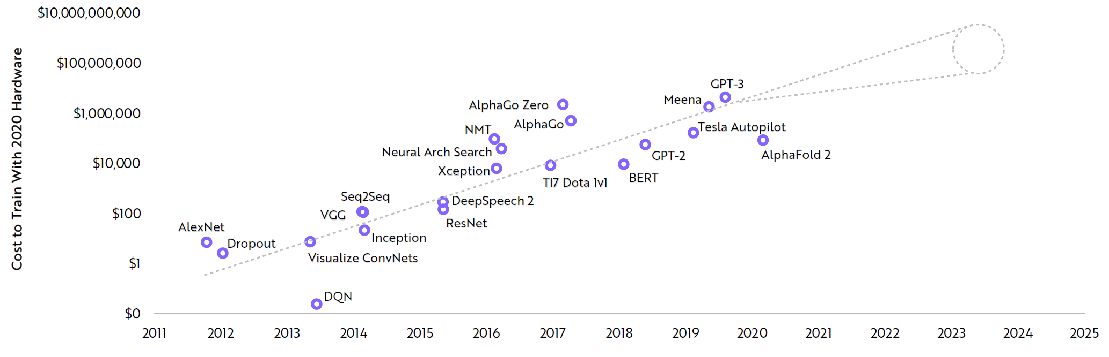
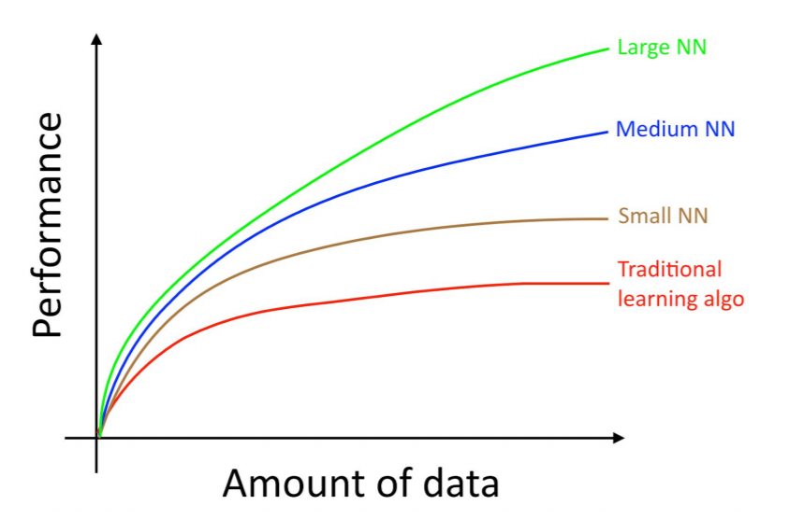
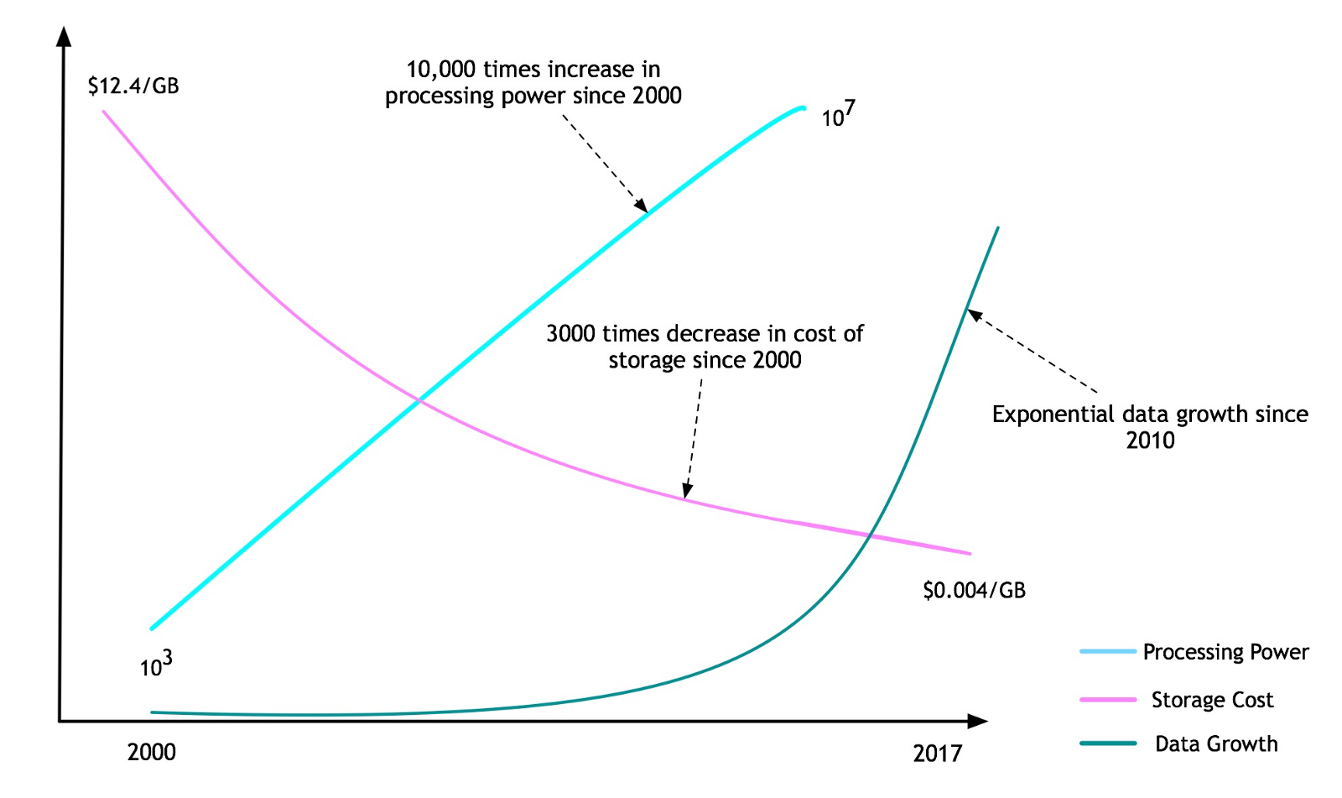
A combination of Data, Computing, Algorithm, Applications
So far, overall effect is still higher training cost
Model size increases ~10x per year + Data size increases
Computing power
Bigger/better model
Why deep model is inevitable
Data
Machine Learning Yearning,

Slide 12
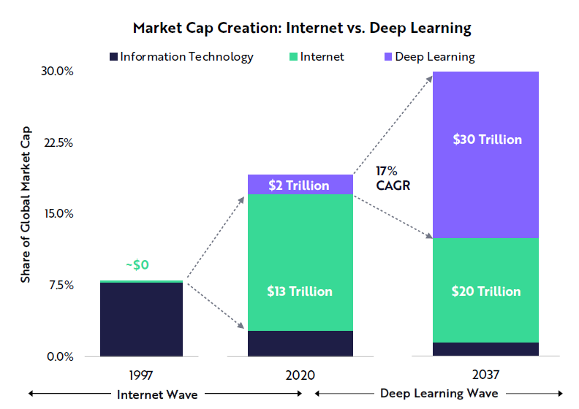
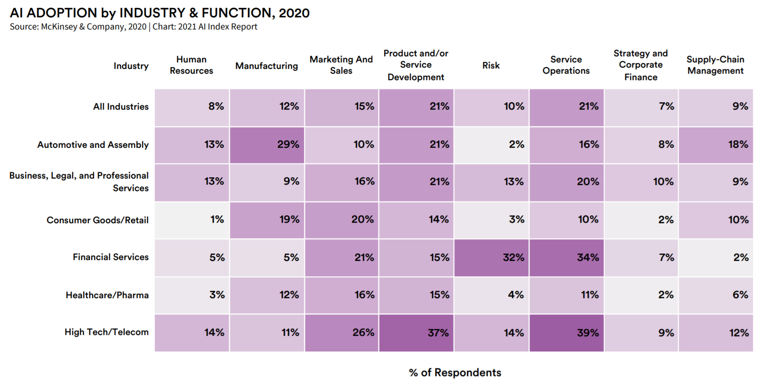
Big future with a long-way to go
According to ARK's research, deep learning will add $30 trillion to the global equity market capitalization during the next 15-20 years.t
-- Big Idea 2021, https://ark-invest.com/big-ideas-2021/
https://aiindex.stanford.edu/wp-content/uploads/2021/03/2021-AI-Index-Report_Master.pdf
Adoption of DL has a long-way to go and requires innovation.

Slide 13
Lecture 1
Motivation
Deep learning as a data driven approach
Running examples
Binary and multi-class classification
Multi-layer perceptron (MLP)

Slide 14
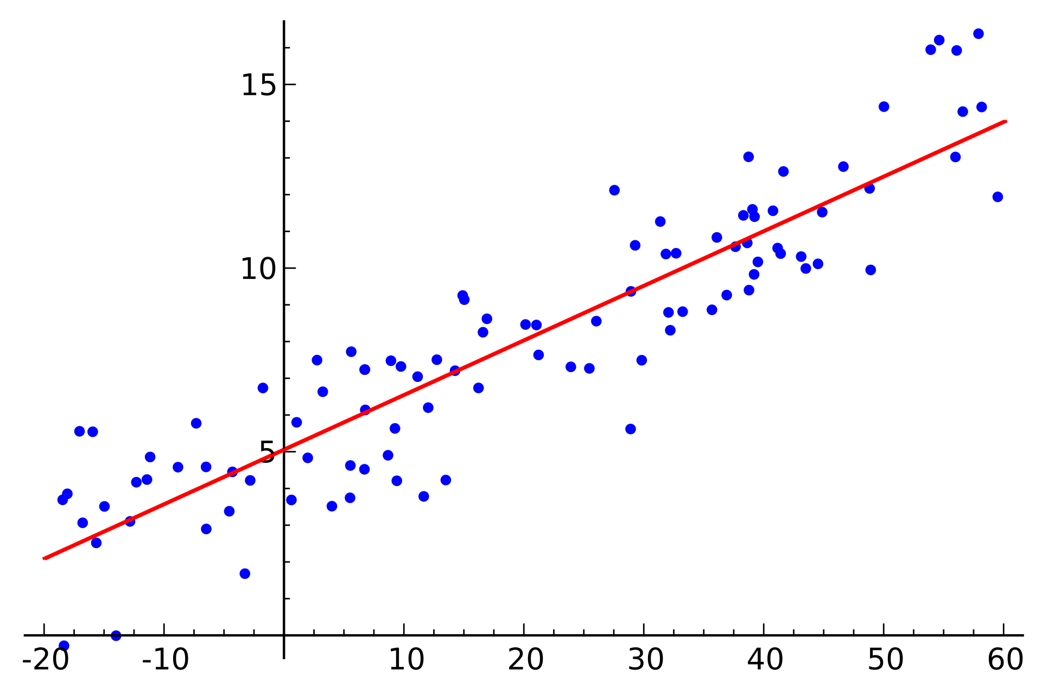
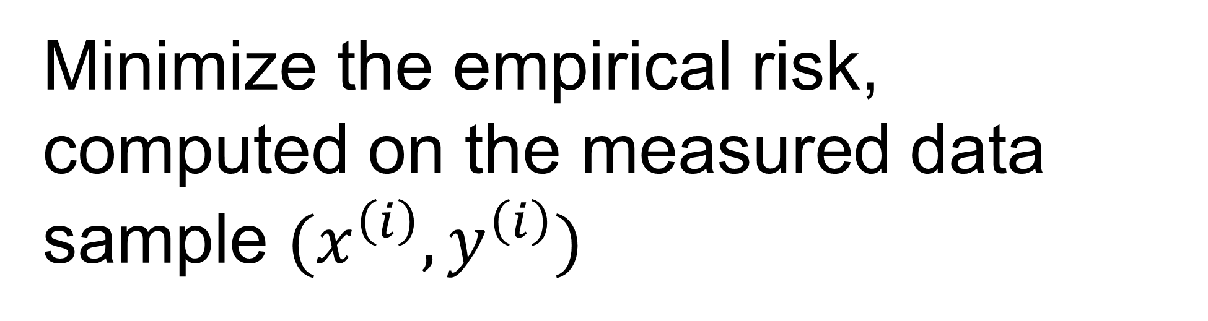
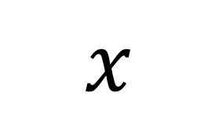
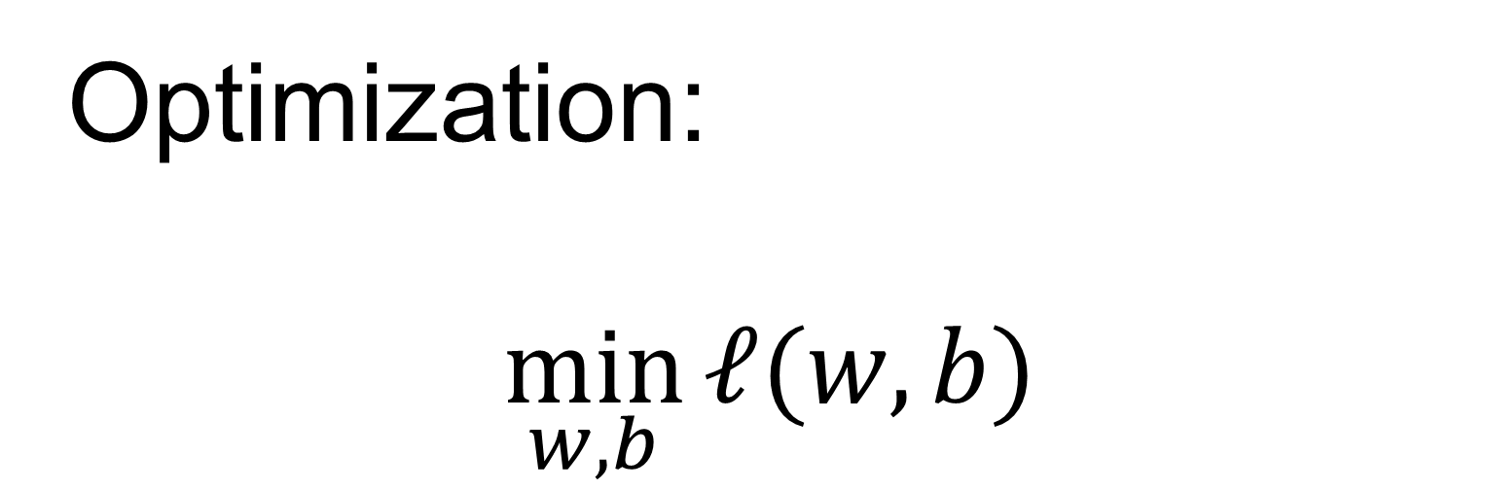
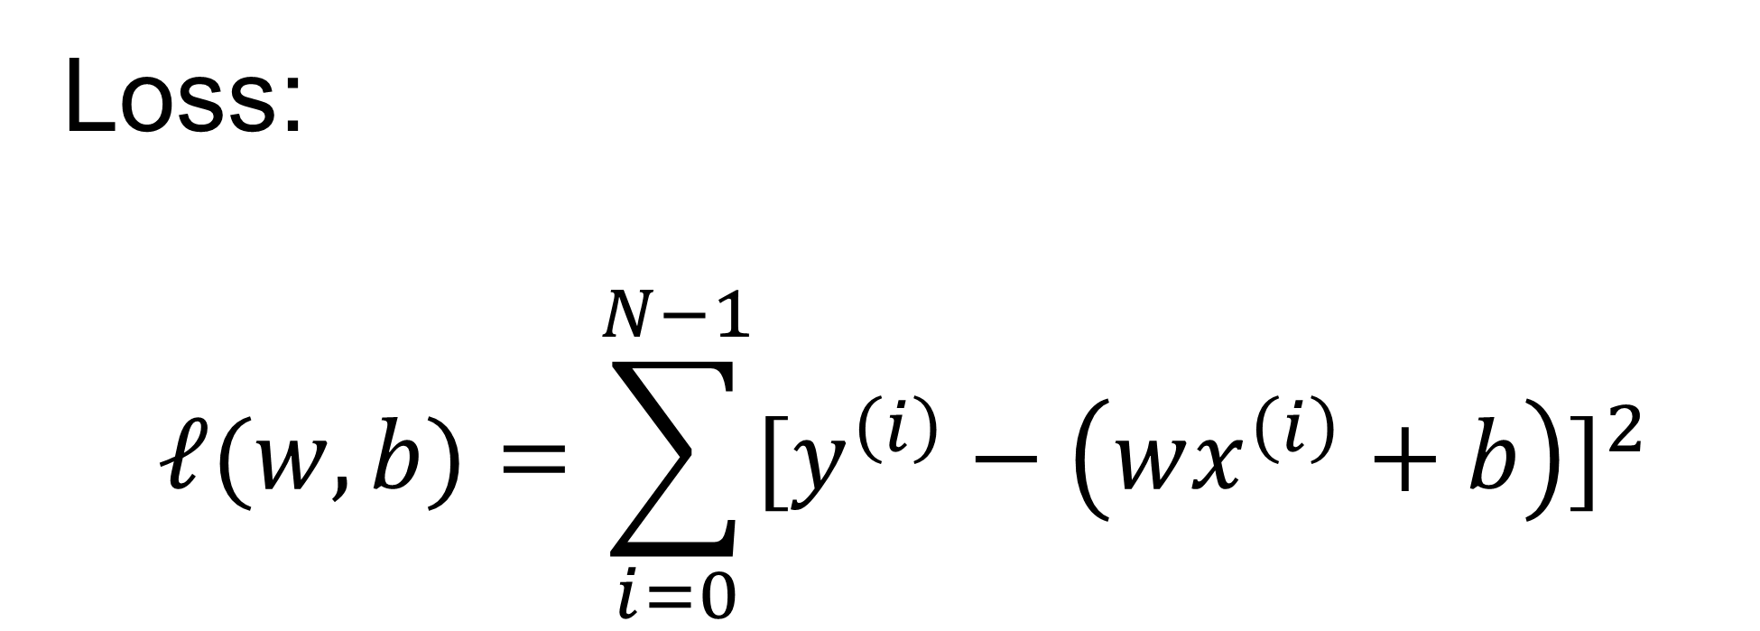
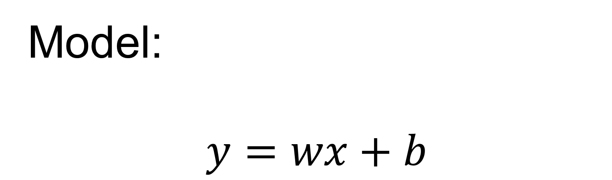
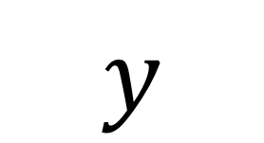
Linear regression
Model:
$$y=wx+b$$
$$y$$
Loss:
$$ℓ(w,b)=\sum_{i=0}^{N−1}{{[y^{\left(i\right)}−\left(wx^{\left(i\right)}+b\right)]}^{2}}$$
Optimization:
$$\min_{w,b}{ℓ(w,b)}$$
$$x$$
Minimize the empirical risk, computed on the measured data sample $(x^{\left(i\right)},y^{\left(i\right)})$
https://en.wikipedia.org/wiki/Linear_regression#/media/File:Linear_regression.svg

Slide 15
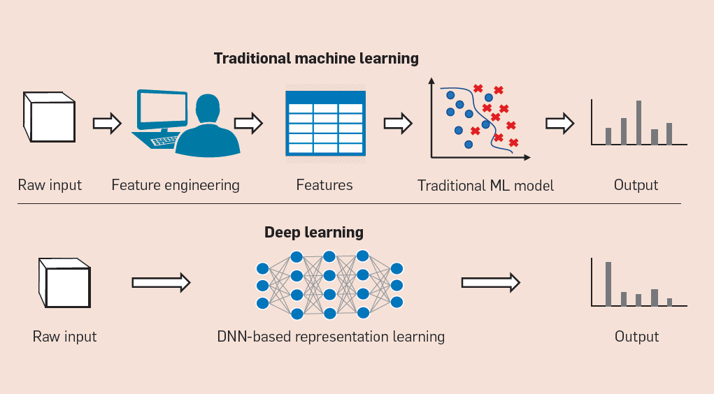
Deep Learning model is data-driven
Learn a good model directly from raw data

Slide 16
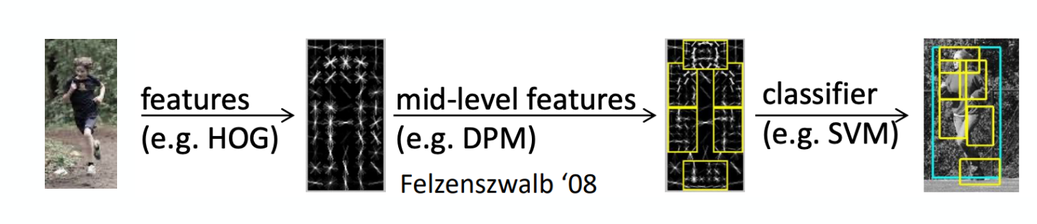
Feature engineering
histogram of oriented gradients
Human design and build feature extractor
Model works on the feature vectors, instead of original data
Limited by the human insights and amount of data
Object Detection with Discriminatively Trained Part Based Models. https://cs.brown.edu/people/pfelzens/papers/lsvm-pami.pdf

Slide 17

Data driven detection
Start from image to object detection (class and bounding box)
End-to-end training, without human crafted features
So powerful, can be done in real-time
https://youtu.be/VOC3huqHrss

Slide 18

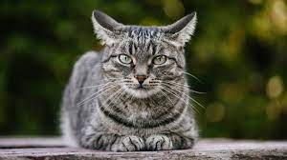

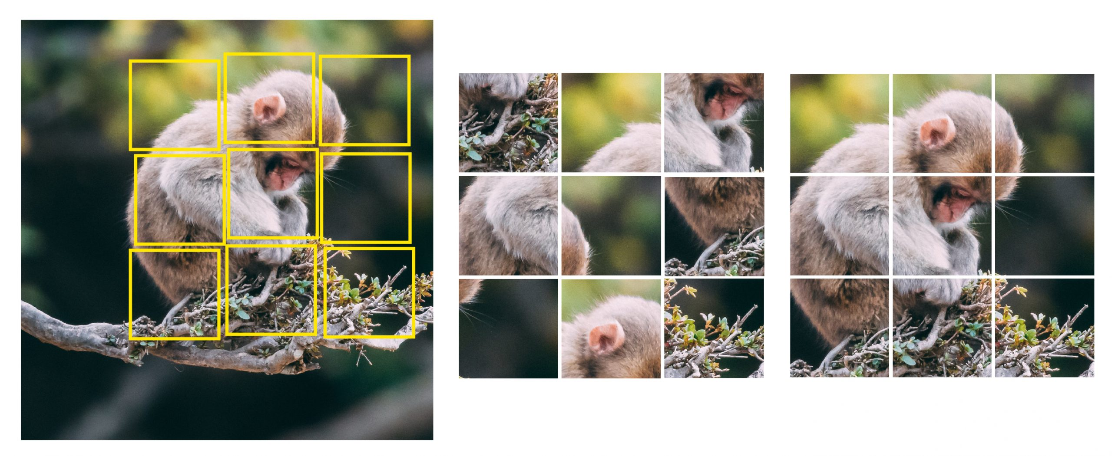
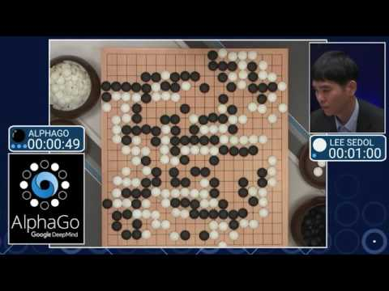
Deep Learning changes the paradigm
Unsupervised Learning
Unlabeled X
Self-supervised Learning
Unlabeled X
Generate self-supervisory signal
Supervised Learning
Learn actions to reach the goal given an environment
Reinforcement Learning
Learn representation in data
Learn effective representation of data to help downstream apps
Labelled X and Y
Learn model: X->Y
Make prediction
Is a cat?
1

Slide 19
Lecture 1
Motivation
Deep learning as a data driven approach
Running examples – heart finding and view classification problem
Binary and multi-class classification
Multi-layer perceptron (MLP)

Slide 20
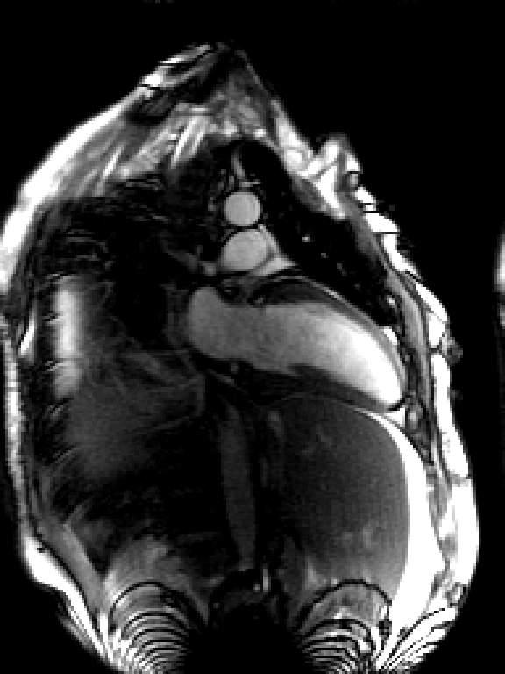
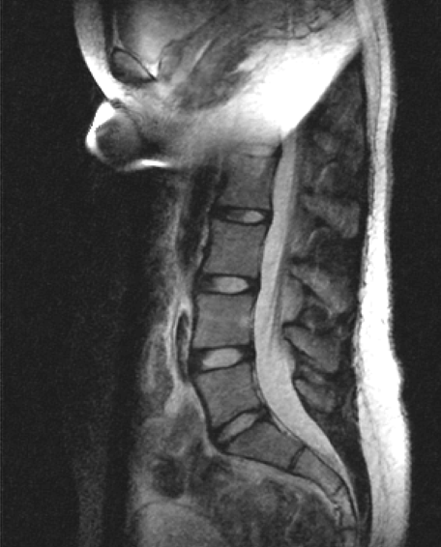
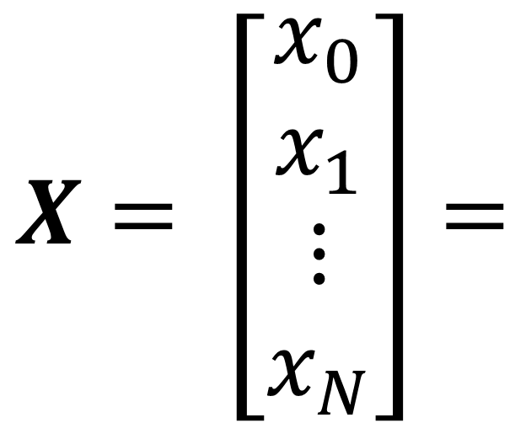
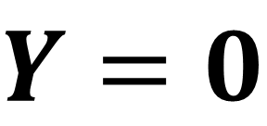
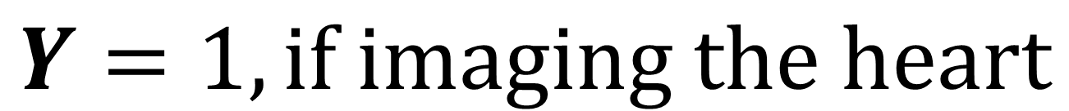
Heart finding problem
A running example : heart finding from MRI images
$$Y=1, if imaging the heart$$
$$X= \left[\begin{matrix}x_{0} \\ x_{1} \\ \begin{matrix}⋮ \\ x_{N}\end{matrix}\end{matrix}\right]=$$
$Y=$ $0$

Slide 21
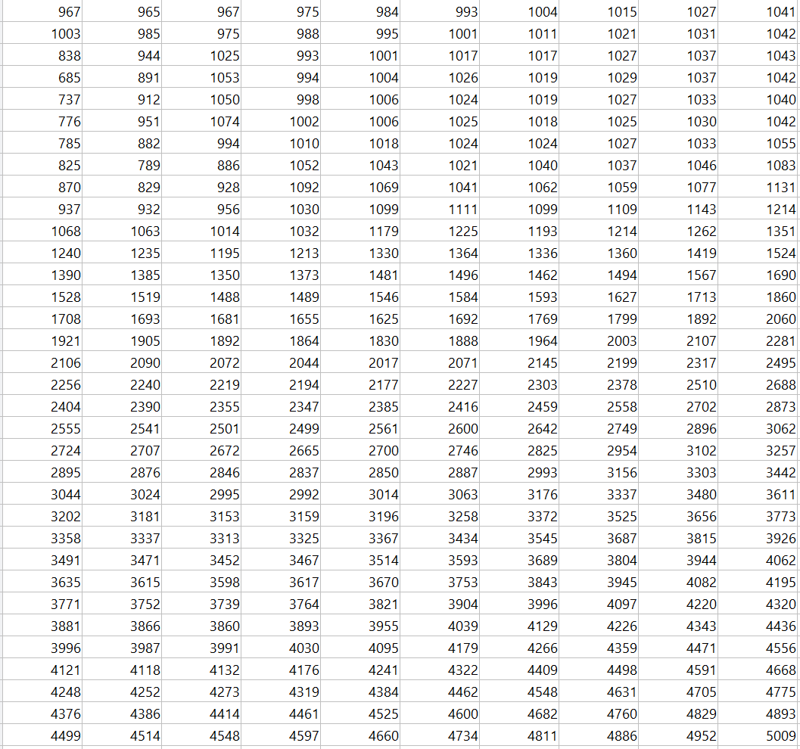
Computer sees the number, not content
What computer sees in this image:

Slide 22
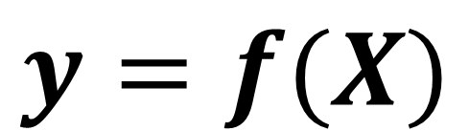
Model as a mapping function
First idea : design a mapping function to map image pixel values to the probability
$$y=f(X)$$
A scalar for the probability where heart was imaged
y : a single floating value
lower case, regular
X : Nx1 vector
N=HxW, number of pixels
upper case, bold

Slide 23
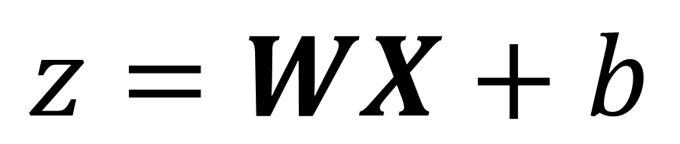
Linear mapping, weights and bias
Start with a linear mapping
$$z=WX+b$$
z : 1x1 scalar
W : 1xN weights matrix
b : 1x1 bias

Slide 24
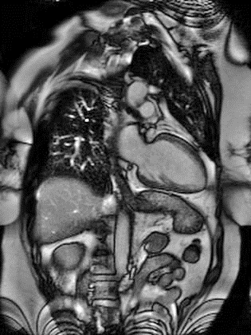
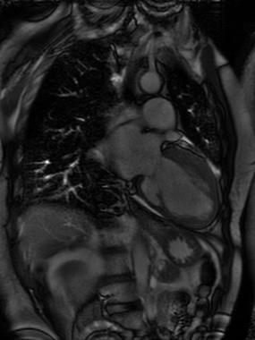
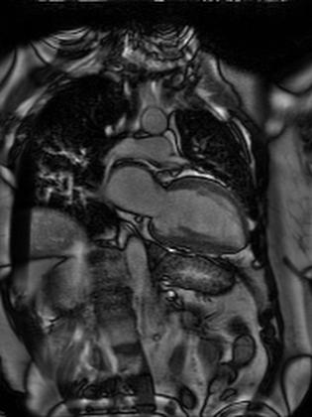
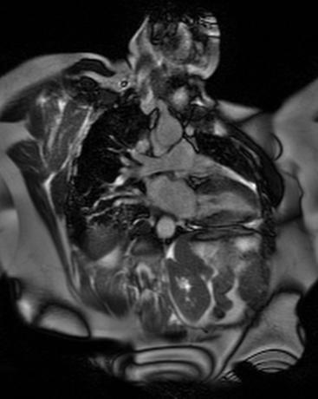
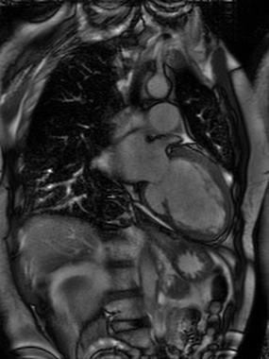
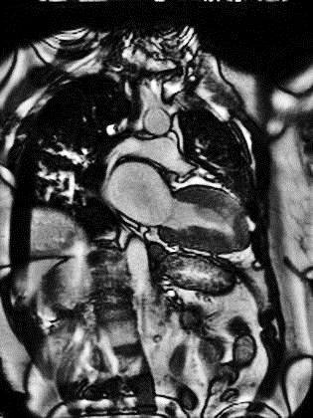
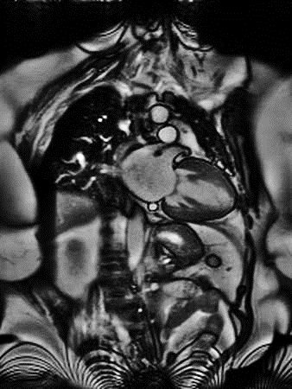
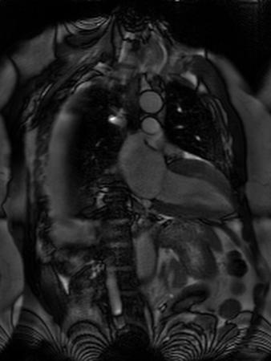
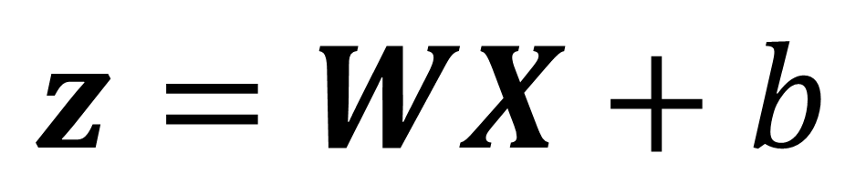
Process a Batch
We can process multiple images in one pass
W and b are the same to all images
B=8, a batch
X : NxB
$$z=WX+b$$
Z : 1xB scalar
score
W : 1xN weights matrix
b : 1x1 bias

Slide 25

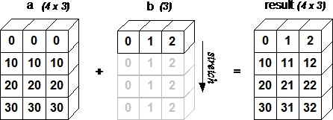
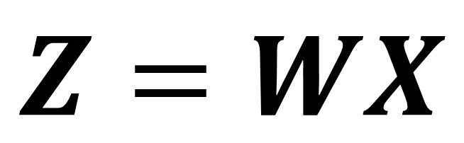
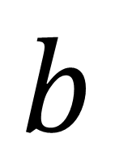

Broadcasting
Question
This sign means you should:
$$Z=WX$$
$$+$$
$$b$$
Add same b to every element of Z
Broadcasting : repeat the smaller array to make its shape compatible to larger array
starts with the trailing (i.e. rightmost) dimensions and works its way left
Repeat any dimension of 1
W : 1xN
X : NxB
So Z is 1xB
1x1 scalar
A (4d array): 8 x 1 x 6 x 1
B (3d array): 7 x 1 x 5
Result (4d array): 8 x 7 x 6 x 5
https://numpy.org/doc/stable/user/basics.broadcasting.html

Slide 26

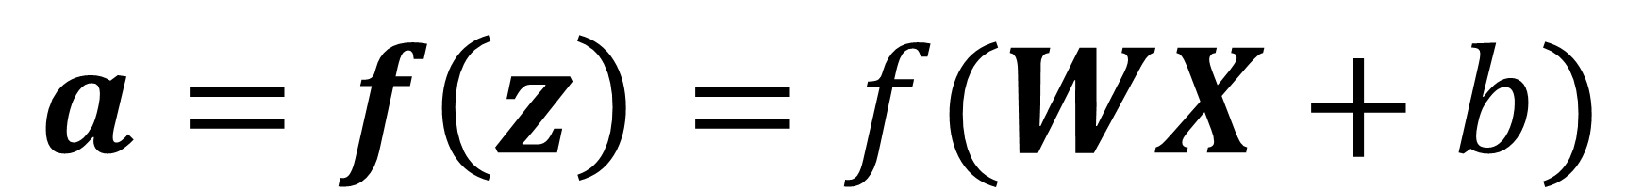
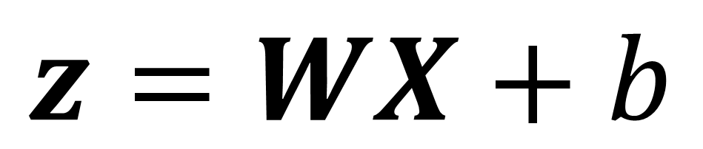
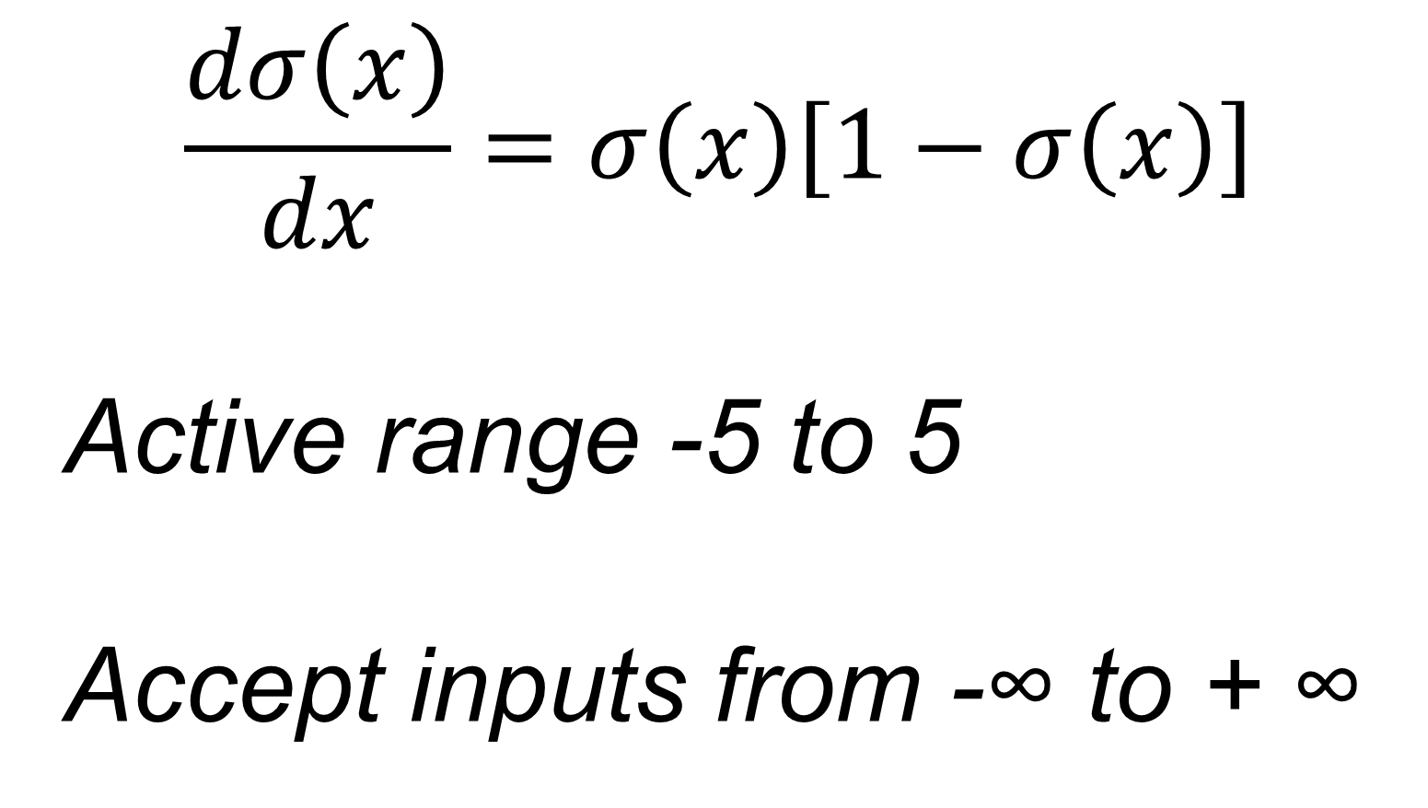

Enforce probability
$$z=WX+b$$
$$a=f\left(z\right)=f(WX+b)$$
f is applied element-wise
A choice of f is the sigmoid function
z is not a value [0 1], so it is not a probability
$$σ\left(x\right)=\frac{1}{1+exp⁡(−x)}$$
Sigmoid function
$$\frac{dσ\left(x\right)}{dx}=σ\left(x\right)\left[1−σ\left(x\right)\right]$$
Active range -5 to 5
Accept inputs from -∞ to + ∞
>5, close to 1
<-5, close to 0

Slide 27

This is a “neuron” in neural network
Neuron = linear mapping + nonlinear activation
Historically, inspired by biological neuron
Not needed to understand today’s deep learning
Building block of DL
Logistic regression if sigmoid nonlinear activation is used
Picture is from https://cs231n.github.io/neural-networks-1/

Slide 28


This concept was invented in 1958
https://www.newyorker.com/magazine/1958/12/06/rival-2
https://medium.datadriveninvestor.com/introduction-to-neural-networks-a0fe9ec0a947

Slide 29



Binary classification
$$a=f\left(z\right)=f(WX+b)$$
>0.5, heart
f
$$a$$
$$X$$
W, b
<0.5, no heart
Only two output status “Yes” or “No”
One scalar is needed
Binary decision

Slide 30





Multi-class classification
Cardiac view detection
E
2 chamber view – CH2
D
3 chamber view – CH3
A
Short-axis view SAX
B
4 chamber view – CH4
https://www.scielo.br/scielo.php?script=sci_arttext&pid=S0066-782X2010001600014&lng=pt&nrm=iso&tlng=pt

Slide 31

Multi-class classification
Cardiac view detection
E
2 chamber view – CH2
D
3 chamber view – CH3
Given an image, decide which imaging view it is
$$Y=\left\{\begin{aligned}\begin{matrix}CH3, 1 & 0 & \begin{matrix}0 & \begin{matrix}0 & 0\end{matrix}\end{matrix} \end{matrix} \\ \begin{matrix}CH2, 0 & 1 & \begin{matrix}0 & \begin{matrix}0 & 0\end{matrix}\end{matrix} \end{matrix} \\ \begin{matrix}CH4, 0 & 0 & \begin{matrix}1 & \begin{matrix}0 & 0\end{matrix}\end{matrix} \end{matrix} \\ SAX, \begin{matrix} 0 & 0 & \begin{matrix}0 & \begin{matrix}1 & 0\end{matrix}\end{matrix} \end{matrix} \\ Other, \begin{matrix} 0 & 0 & \begin{matrix}0 & \begin{matrix}0 & 1\end{matrix}\end{matrix} \end{matrix}\end{aligned}\right.$$
A
Short-axis view SAX
Now we need 5 numbers for K=5 classes
This type of encoding y is “one-hot encoding”
B
4 chamber view – CH4

Slide 32







Multi-class classification
W0, b0
$$z_{0}$$
Generate 5 numbers as the score for each class
W1, b1
$$z_{1}$$
$$Z=[z_{0},z_{1},z_{2},z_{3},z_{4}]$$
$$X$$
W2, b2
$$z_{2}$$
X : NxB, images
W0, W1, …, W4: 1XN weights
b0, b1, …, b4: 1x1 bias
W3, b3
$$z_{3}$$
W4, b4
$$z_{4}$$

Slide 33


Multi-class classification
X : NxB, images
W0, W1, …, W4: 1XN weights
b0, b1, …, b4: 1x1 bias
We can put all weights in one matrix and bias
W0, b0
$$z_{0}$$
W1, b1
$$z_{1}$$
$$X$$
$$W=\left[\begin{matrix}\begin{matrix}− & W0 & −\end{matrix} \\ \begin{matrix}− & W1 & −\end{matrix} \\ \begin{matrix}\begin{matrix}− & W2 & −\end{matrix} \\ \begin{aligned}\begin{matrix}− & W3 & −\end{matrix} \\ \begin{matrix}− & W4 & −\end{matrix}\end{aligned}\end{matrix}\end{matrix}\right]$$
W2, b2
$$z_{2}$$
KxN matrix, every row for each class
W3, b3
$$z_{3}$$
$$b=\left[\begin{aligned}b0 \\ b1 \\ b2 \\ b3 \\ b4\end{aligned}\right]$$
Kx1 vector
W4, b4
$$z_{4}$$

Slide 34

Multi-class classification
W0, b0
$$z_{0}$$
Matrix representation:
W1, b1
$$z_{1}$$
$$z= WX+b$$
$$X$$
W2, b2
$$z_{2}$$
X: NxB, input images
W: KxN, weights
b: Kx1, bias
Z: KxB, score
W3, b3
$$z_{3}$$
W4, b4
$$z_{4}$$

Slide 35



Softmax
softmax
W0, b0
$$z_{0}$$
$$softmax\left(Z\right)=\frac{exp⁡(z_{i})}{\sum_{j=0}^{K}{{exp⁡(z}_{j})}}$$
W1, b1
$$z_{1}$$
$$X$$
W2, b2
$$z_{2}$$
$$a$$
Softmax trick:
W3, b3
$$z_{3}$$
$$softmax\left(Z−c\right)=softmax(Z)$$
$$compute softmax\left(Z\right) as softmax\left(Z−max(Z) \right)$$
W4, b4
$$z_{4}$$
Better numeric stability

Slide 36

Logits
softmax
W0, b0
$$z_{0}$$
When score Z is used as inputs to softmax, it is also called “logits”
W1, b1
$$z_{1}$$
In the machine learning, logits can be defined as a vector of raw predictions that are inputted into normalization function to generate probabilities.
$$X$$
W2, b2
$$z_{2}$$
$$a$$
$$logits\left(a\right)=log⁡(\frac{a}{1−a})$$
$$a ∈\left[0, 1\right], logits∈(−∞, +∞)$$
W3, b3
$$z_{3}$$
W4, b4
$$z_{4}$$

Slide 37





Universal Approximation
Question
This sign means you should:
W₁^{[1]}
f
$$X$$
W₂^{[1]}
f
W₁^{[2]}
f
… …
… …
W_{N}^{[1]}
f
Can a MLP approximate any functions?
https://www.sfu.ca/~ssurjano

Slide 38


Universal Approximation
Question
This sign means you should:
Can a MLP approximate any functions?
W₁^{[1]}
f
$$X$$
W₂^{[1]}
f
W₁^{[2]}
… …
… …
https://doi.org/10.1016/0893-6080(91)90009-T
W_{N}^{[1]}
f
In short: A MLP with at least one hidden layer and nonlinear activation function can approximate any continuous function.
https://en.wikipedia.org/wiki/Universal_approximation_theorem

Slide 39


Binary vs. multi-class classification
Binary
Multi-class
$$a=σ(WX+b)$$
$$a=softmax(WX+b)$$
X : NxB
W : 1xN
b : 1x1
a : 1xB
Apply sigmoid element-wise
X : NxB
W : KxN
b : Kx1
a : KxB
Apply softmax along class K
We used one layer of linear mapping and one nonlinear activation function

Slide 40

Activation functions
Question
This sign means you should:

Slide 41
Lecture 1
Motivation
Deep learning as a data driven approach
Running examples
Binary and multi-class classification
Multi-layer perceptron (MLP)

Slide 42


Multi-layer Perceptron (MLP)
W₁^{[1]}
f
W₁^{[2]}
f
Index of layer
flatten
f
f
W₁^{[2]}
$$X$$
W₂^{[1]}
W₁^{[3]}
$$a^{[3]}$$
W₂^{[2]}
f
Index of neuron
W₃^{[1]}
f

Slide 43

Multi-layer Perceptron (MLP)
W₁^{[1]}
f
W₁^{[2]}
f
Index of layer
flatten
f
f
W₁^{[2]}
$$X$$
W₂^{[1]}
W₁^{[3]}
$$a^{[3]}$$
W₂^{[2]}
f
Index of neuron
W₃^{[1]}
f
Layer 3 / output layer
Hidden Layer 1
Hidden Layer 2

Slide 44



Multi-layer Perceptron (MLP)
W₁^{[1]}
f
X : N x1
W^{[1]} : 3xN
b^{[1]} : 3x1
Z^{[1]} : 3x1
a^{[1]} : 3x1
f : applied element-wise
$$X$$
W₂^{[1]}
f
$$Z^{[1]}=W^{\left[1\right]}X+b^{[1]}$$
$$a^{[1]}=f(Z^{\left[1\right]})$$
W₃^{[1]}
f

Slide 45



Multi-layer Perceptron (MLP)
a^{[1]} : 3x1
W^{[2]} : 2x3
b^{[2]} : 2x1
Z^{[2]} : 2x1
a^{[2]} : 2x1
f : applied element-wise
W₁^{[2]}
f
$$a^{[1]}$$
$$Z^{[2]}=W^{\left[2\right]}X+b^{[2]}$$
$$a^{[2]}=f(Z^{\left[2\right]})$$
W₂^{[2]}
f

Slide 46



Multi-layer Perceptron (MLP)
a^{[2]} : 2x1
W^{[3]} : 1x2
b^{[3]} : 1x1
Z^{[3]} : 1x1
a^{[3]} : 1x1
f : applied element-wise
W₁^{[3]}
f
$$Z^{[3]}=W^{[3]}a^{[2]}+b^{[3]}$$
$$a^{[2]}$$
$$a^{[3]}=f(Z^{\left[3\right]})$$

Slide 47







Forward Pass
$$Z^{[1]}=W^{\left[1\right]}X+b^{[1]}$$
$$a^{[1]}=f(Z^{\left[1\right]})$$
Forward pass: from input X to output $\hat{y}$
For every layer,
W.shape is [number of output, number of input]
b.shape is [number of input, 1]
$$Z^{[2]}=W^{\left[2\right]}X+b^{[2]}$$
$$a^{[2]}=f(Z^{\left[2\right]})$$
$$Z^{[3]}=W^{[3]}a^{[2]}+b^{[3]}$$
$${\hat{y}=a}^{[3]}=f(Z^{\left[3\right]})$$

Slide 48








Number of parameters?
W₁^{[1]}
f
$$Z^{[1]}=W^{\left[1\right]}X+b^{[1]}$$
3N+3
W₁^{[2]}
f
$$a^{[1]}=f(Z^{\left[1\right]})$$
0
$$X$$
W₂^{[1]}
f
W₁^{[3]}
f
$$a^{[3]}$$
$$Z^{[2]}=W^{\left[2\right]}X+b^{[2]}$$
2x3+2=8
$$a^{[2]}=f(Z^{\left[2\right]})$$
0
W₂^{[2]}
f
$$Z^{[3]}=W^{[3]}a^{[2]}+b^{[3]}$$
1x2+1=3
f
$${\hat{y}=a}^{[3]}=f(Z^{\left[3\right]})$$
0
W₃^{[1]}
3N+14

Slide 49




Nonlinear activation is necessary
W₁^{[1]}
f
$$Z^{[1]}=W^{\left[1\right]}X+b^{[1]}$$
W₁^{[2]}
f
$$a^{[1]}=Z^{\left[1\right]}$$
$$X$$
W₂^{[1]}
f
W₁^{[3]}
f
$$a^{[3]}$$
$$Z^{[2]}=W^{\left[2\right]}a^{[1]}+b^{[2]}$$
$$a^{[2]}=Z^{\left[2\right]}$$
W₂^{[2]}
f
$$Z^{[3]}=W^{[3]}a^{[2]}+b^{[3]}$$
W₃^{[1]}
f
$${\hat{y}=a}^{[3]}=Z^{\left[3\right]}=W^{[3]}a^{[2]}+b^{[3]}$$
$$={W^{[3]}(W}^{\left[2\right]}a^{[1]}+b^{[2]})+b^{[3]}$$
$$={W^{\left[3\right]}(W}^{\left[2\right]}(W^{\left[1\right]}X+b^{\left[1\right]})+b^{\left[2\right]})+b^{\left[3\right]}$$
$=$ ${W^{\left[3\right]}W}^{\left[2\right]}W^{\left[1\right]}X$+ ${W^{\left[3\right]}W}^{\left[2\right]}b^{[1]}+W^{\left[3\right]}b^{\left[2\right]}+b^{\left[3\right]}$
A linear model …

